Slide 1

1b: KF Tracking a circle
ps5-1-b-1.png
Computer Vision @ GT

Slide 2

1b: KF Tracking a circle (cont.)
ps5-1-b-2.png
Computer Vision @ GT

Slide 3
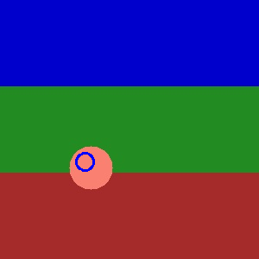
1b: KF Tracking a circle (cont.)
ps5-1-b-3.png
Computer Vision @ GT

Slide 4
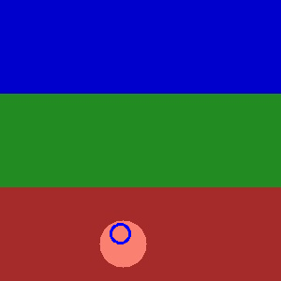
1b: KF Tracking a circle (cont.)
ps5-1-b-4.png
Computer Vision @ GT

Slide 5
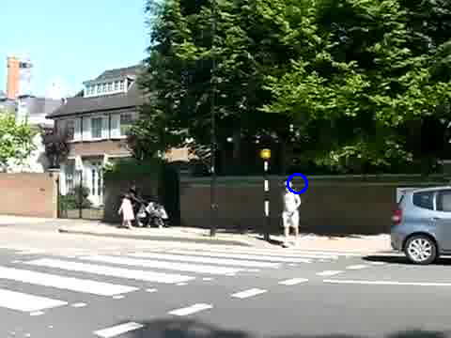
1c: KF Tracking pedestrians
ps5-1-c-1.png
Computer Vision @ GT

Slide 6
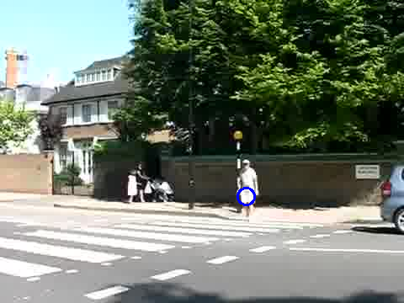
1c: KF Tracking pedestrians
ps5-1-c-2.png
Computer Vision @ GT

Slide 7
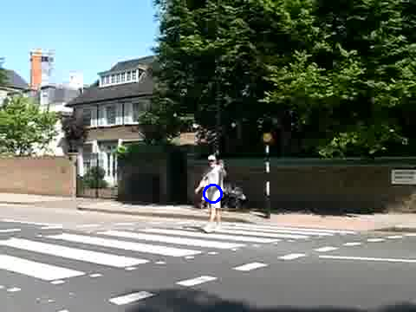
1c: KF Tracking pedestrians
ps5-1-c-3.png
Computer Vision @ GT

Slide 8
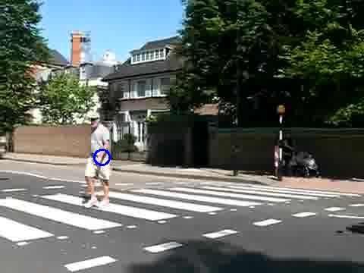
1c: KF Tracking pedestrians
ps5-1-c-4.png
Computer Vision @ GT

Slide 9
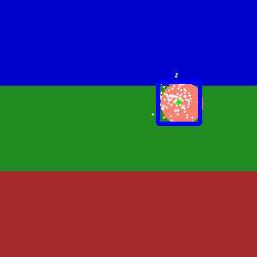
2a: PF Tracking a circle
ps5-2-a-1.png
Computer Vision @ GT

Slide 10

2a: PF Tracking a circle (cont.)
ps5-2-a-2.png
Computer Vision @ GT

Slide 11
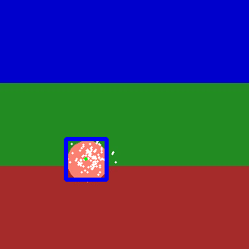
2a: PF Tracking a circle (cont.)
ps5-2-a-3.png
Computer Vision @ GT

Slide 12

2a: PF Tracking a circle (cont.)
ps5-2-a-4.png
Computer Vision @ GT

Slide 13
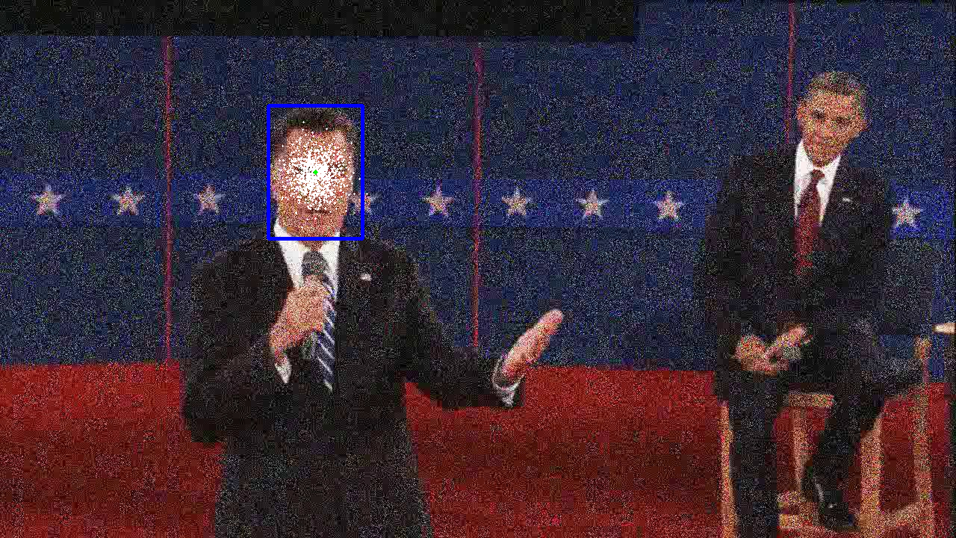
2b: PF Tracking noisy video
ps5-2-b-1.png
Computer Vision @ GT

Slide 14
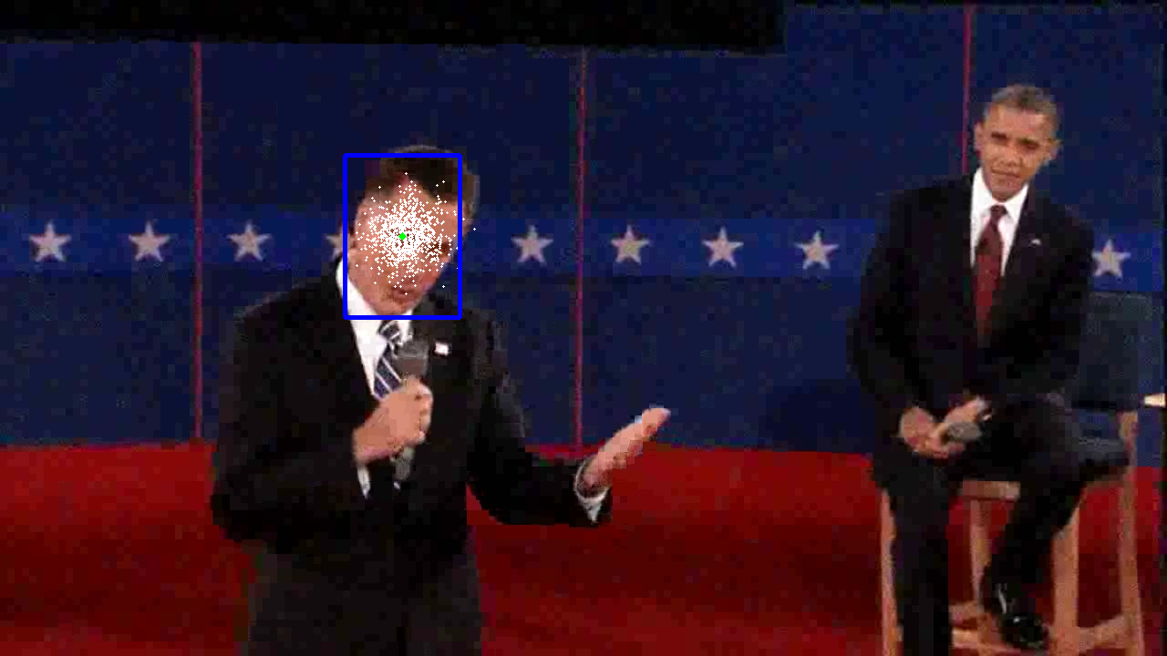
2b: PF Tracking noisy video (cont.)
ps5-2-b-2.png
Computer Vision @ GT

Slide 15
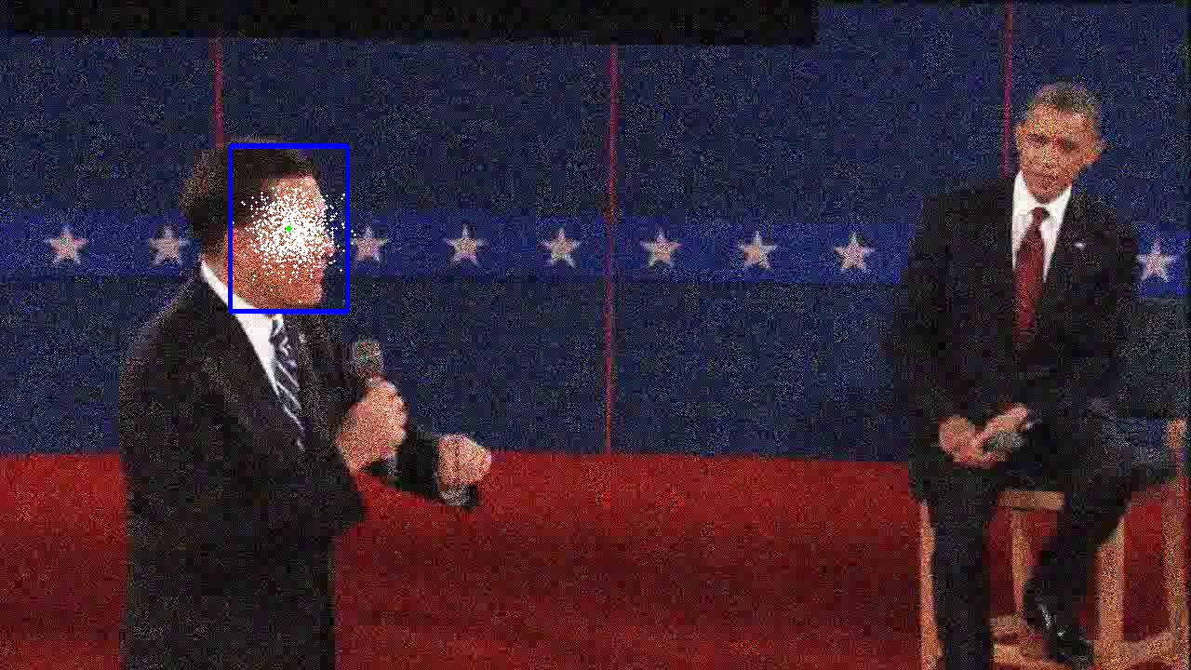
2b: PF Tracking noisy video (cont.)
ps5-2-b-3.png
Computer Vision @ GT

Slide 16
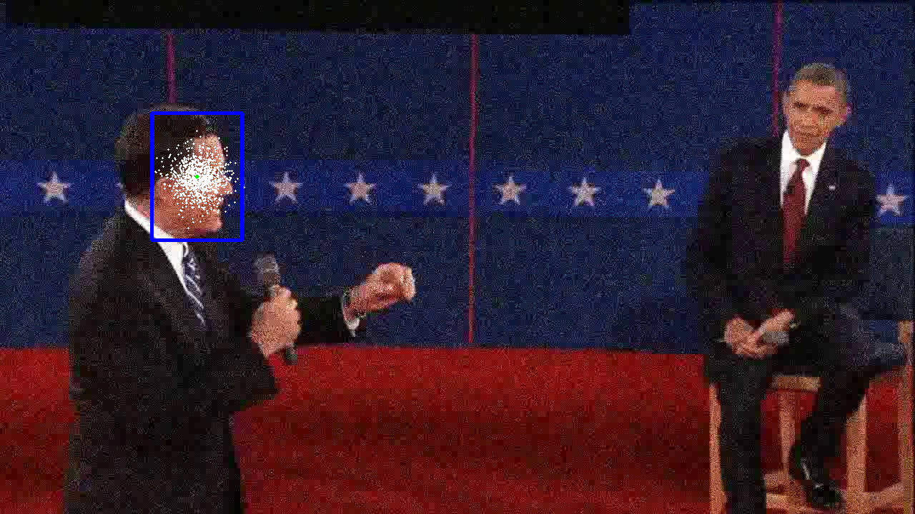
2b: PF Tracking noisy video (cont.)
ps5-2-b-4.png
Computer Vision @ GT

Slide 17
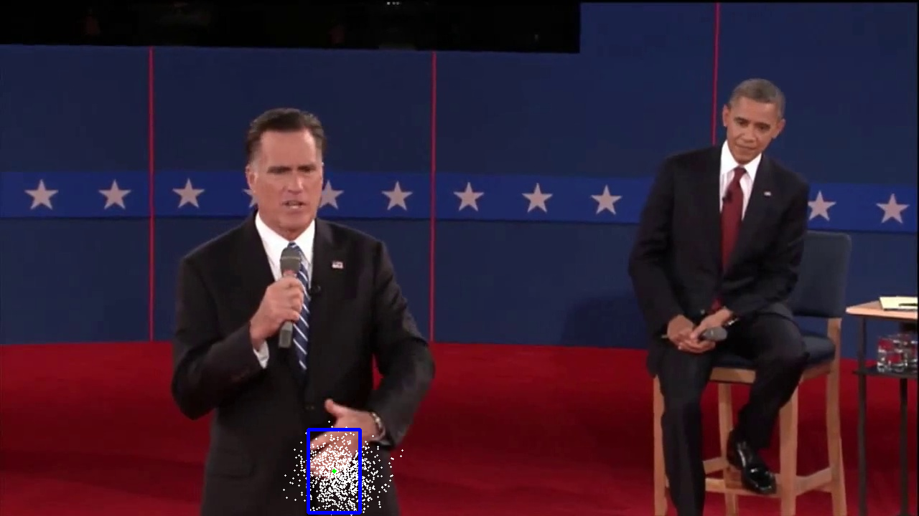
3a: PF Changes in Appearance
ps5-3-a-1.png
Computer Vision @ GT

Slide 18
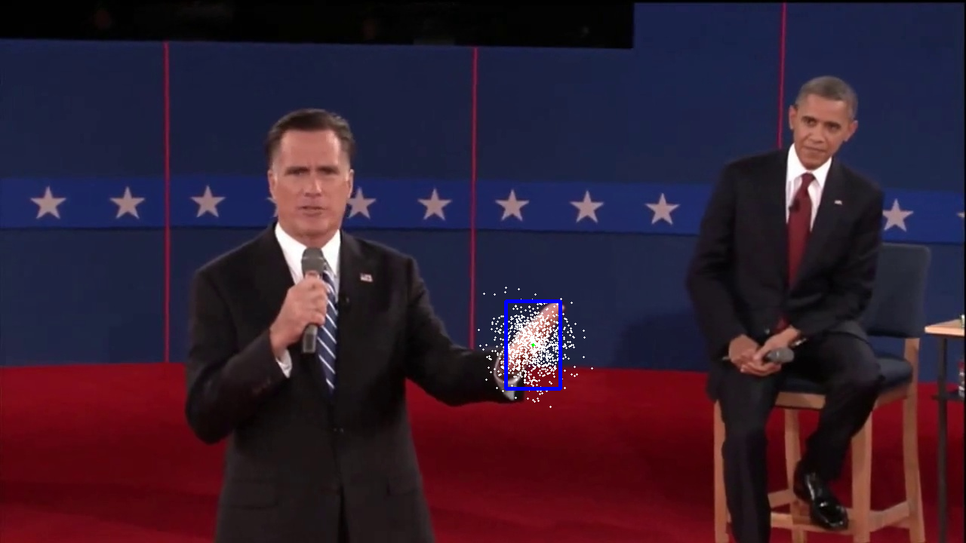
3a: PF Changes in Appearance (cont.)
ps5-3-a-2.png
Computer Vision @ GT

Slide 19
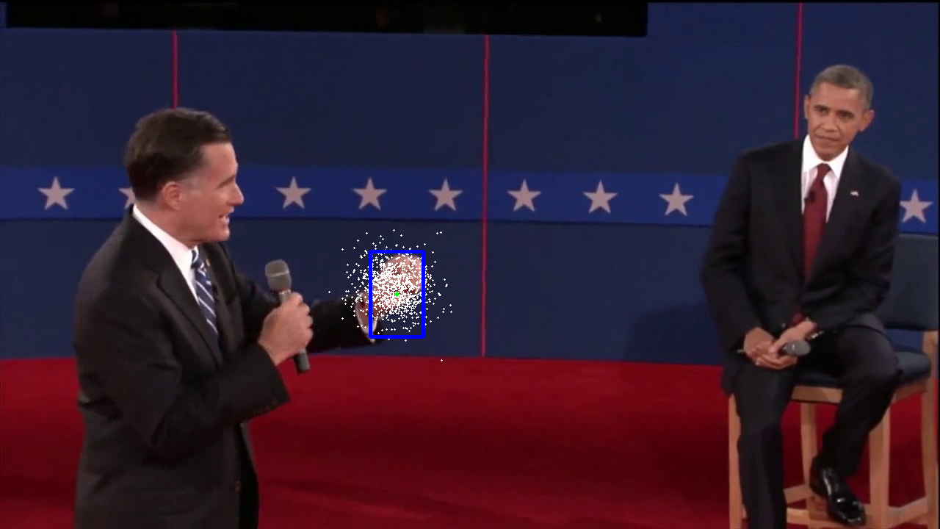
3a: PF Changes in Appearance (cont.)
ps5-3-a-3.png
Computer Vision @ GT

Slide 20
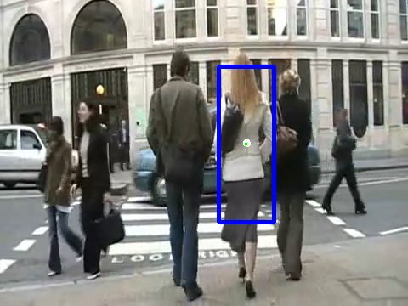
4a: PF Occlusions
ps5-4-a-1.png
Computer Vision @ GT

Slide 21
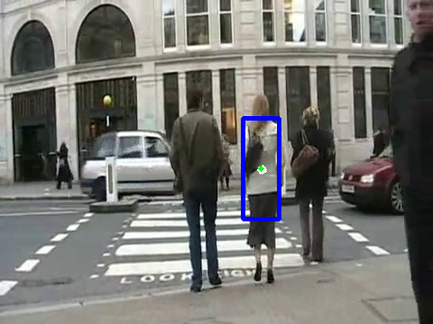
4a: PF Occlusions (cont.)
ps5-4-a-2.png
Computer Vision @ GT

Slide 22
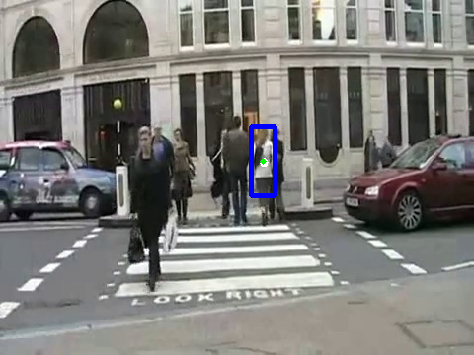
4a: PF Occlusions (cont.)
ps5-4-a-3.png
Computer Vision @ GT

Slide 23
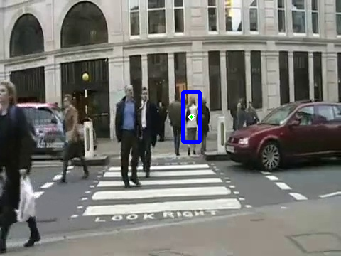
4a: PF Occlusions (cont.)
ps5-4-a-4.png
Computer Vision @ GT

Slide 24
4: Text response
Firstly, I had to adapt template for each frame. As woman walks away, template should also have the ability to scale down. For that I’ve added another parameter to particles’ state – scale, that defines how much template should be scaled. Rendered output shows template window with weighted sum of all particle window sizes.
Secondly, I lowed sigma value for particle movements, so that when occlusion happens particles don’t scatter away too much. But this approach works only when object hasn’t moved too far away along X or Y axis.
Another approach would be to redistribute particles across the whole image if template matching shows poor results. That way, when object reappear at least some particles can find it again and new particles can be resampled from those.
Computer Vision @ GT

Slide 25
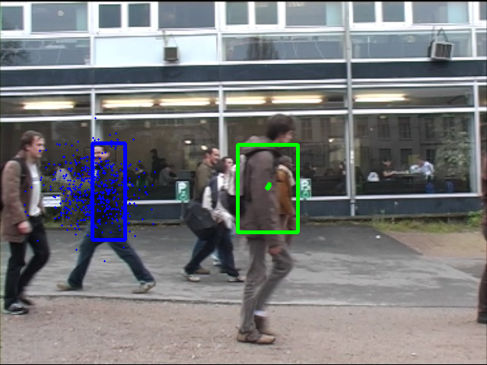
5: Tracking multiple targets
ps5-5-a-1.png
Computer Vision @ GT

Slide 26
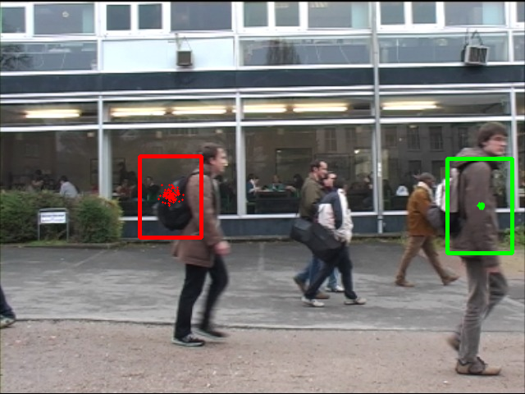
5: Tracking multiple targets (cont.)
ps5-5-a-2.png
Computer Vision @ GT

Slide 27
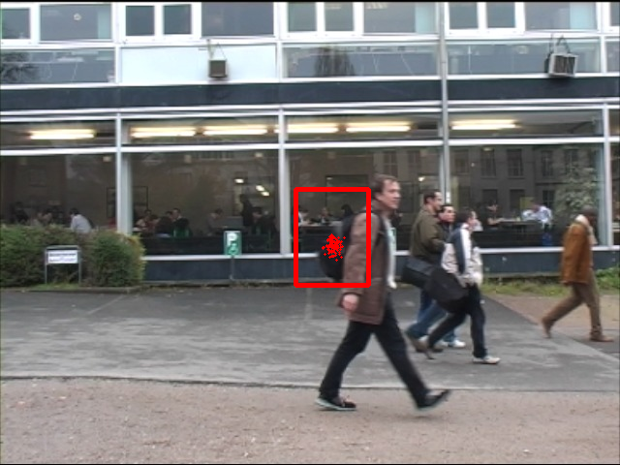
5: Tracking multiple targets (cont.)
ps5-5-a-3.png
Computer Vision @ GT

Slide 28
5: Text response
What I did:
1) Introduced horizontal velocity as another parameter to particle state. That way objects can be tracked even when they’re occluded by another object, as long as they move at near constant speed;
2)To track multiple objects I created separate filter for each object. Each filter can also be tuned for specific target (including frame when object tracking should begin). Since filters work independently I didn’t have to add any special changes to filters themselves.
3)Chose template for each target. Man in black was the easiest one to track even though he was occluded several time. Other two people on the other hand were wearing brown jackets which are similar in color to the background (bushes, road). So to track other two I chose parts that don’t change much and have unique color - their backpack and shoulder area.
Kalman filter vs Particle filter:
I tried tracking people with Kalman filter, but faced a lot of difficulties that caused target point to lose its target. What I found out is that you have to add velocity to transition matrix and pick good template. The last part was especially difficult to tune. Particle filter on the other hand was slower but much more robust, since even if a few particles wander off, others will compensate for that in numbers.
Computer Vision @ GT

